Slide 1
HttpUtils is Dead, Long Live …
Integration Testing for DropWizard Apps
Code Stored at MadDogTechnology/app-service-common-test

Slide 2
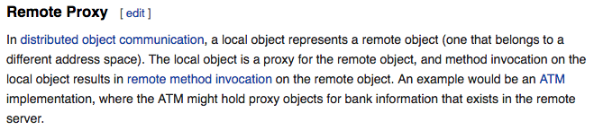
Where did HttpUtils come from?
HttpUtils was hastily slapped together to serve as a Remote Proxy for invoking APIs exposed by our DropWizard apps.
The purpose of a Remote Proxy is to:
Shield the client code from the complexities of issuing remote method invocations,
Hide the fact that a remote method invocation is being issued at all.
HttpUtils gave our test clients a single point of access for all API calls.

Slide 3
Problems with HttpUtils
Too many methods:
makes maintenance difficult;
suggests a violation of the Single Responsibility Priniciple of OO Design.
Too much boilerplate code:
Instantiate an OkHttpClient object with the same connectTimeout and readTimeout in every method.
Create an HttpUrl object with a base of "http://localhost:" + serverPort
Recreate the same AuthUser object for purposes of populating the X-User-Data request header.
Create a Request object, setting the X-User-Data header
Deserialize the Response body, using a Jackson ObjectMapper.
Bad coding practices!

Slide 4

Bad Coding Practices
OkHttpClient object should be instantiated once and reused:
We should not be instantiating an OkHttpClient object in every method; ideally, we should just create one OkHttpClient object and reuse it everywhere.
Query string parameters must be URL encoded:
BAD:
GOOD:

Slide 5
Bad Coding Practices
HttpUtils methods should not return a Response object!
Resource leaks: Response objects should always be placed in a try-resources block so that they are properly closed! Otherwise, you create a resource leak.
Bad Separation of Concerns:
A Remote Proxy is supposed to shield the client code from the fact that we are using the okhttp3 library to issue remote method invocations. The exception is when you want to make assertions about protocol-specific items such as:
Response code equals 403
Response contains a content-type header set to “application/zip”
Even in such cases, you should not return a response. Either throw a BadResponseException or return an HttpResponse decorator which allows the Response to be closed.

Slide 6
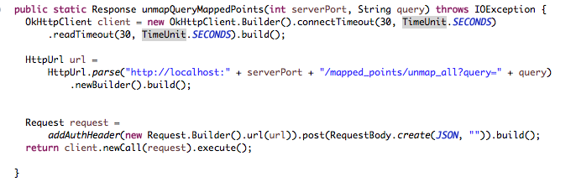
Bad Coding Practices
HttpUtils methods should not return a Response object (cont’d)
BAD
GOOD

Slide 7
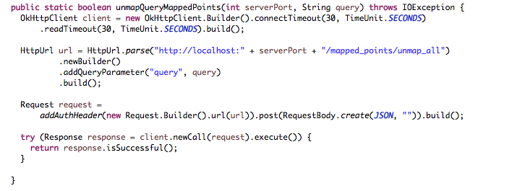
Bad Coding Practices
HttpUtils methods should not return a Response object (cont’d)
GOOD
GOOD

Slide 8
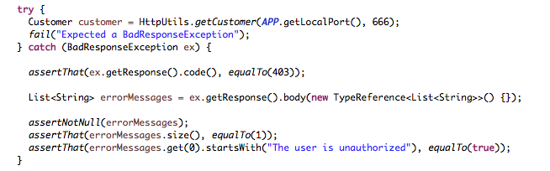
Good Coding Practices
Remote Proxy methods should return domain objects, whenever possible.
If a request is not successful, you should throw a BadResponseException. Why?
In many cases, an error response will contain a body that has a different JSON format than a success response. A method can only return one type!

Slide 9
The Successor to HttpUtils: HttpClient
Every integration test class should extend the AbstractIntegrationTest class.
This eliminates all of the boilerplate code at the top of these classes, and gives the class access to an HttpClient object named client.
The HttpClient object acts as a common façade, providing access to a set of resource-specific remote proxy objects.
For instance, client.customersApi()returns a handle to a
CustomersApiClient object. You can use this handle to invoke REST APIs exposed by the CustomersResource class, such as
Customer cust = client.customersApi().getCustomer(1);

Slide 10
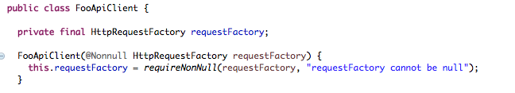
HttpClient (cont’d)
When you develop a new JAX-RS resource, such as FooResource, you will create a new class in the integration.httpclient package with a name such as FooApiClient.
This class should have a package-private constructor that accepts an HttpRequestFactory object and uses it to initialize a private final data member named requestFactory.

Slide 11
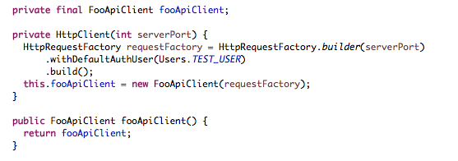
HttpClient (cont’d)
After creating your FooApiClient class, you will create an instance of that class as a private final data member within the HttpClient class, you will initialize that data member within the HttpClient constructor, and you will expose an accessor which returns that data member.

Slide 12
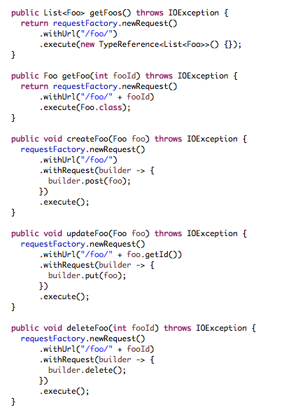
HttpRequestFactory
Next, you’ll start adding remote invocation methods within the FooApiClient class using the requestFactory object instead of using the okhttp3 library directly.

Slide 13
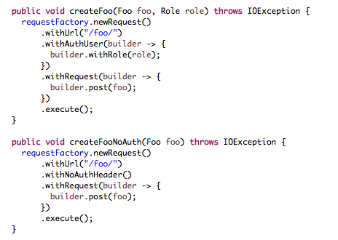
HttpRequestFactory: Custom X-User-Data

Slide 14
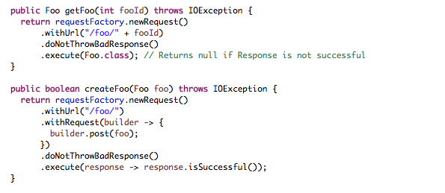
HttpRequestFactory: Don’t Throw BadResponse

Slide 15
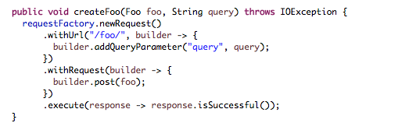
HttpRequestFactory: Add Query Params

Slide 16
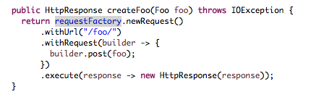
HttpRequestFactory: Return HttpResponse
WARNING: Only do this if you need to validate HTTP response headers on a successful response. For unsuccessful responses, you can get what you need from the BadResponseException object that gets thrown. For instance, you might want to validate that the Content-Type header has been set to “application/zip” on a successful request for export content.

Slide 17
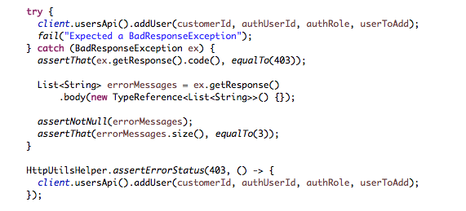
HttpRequestFactory: Handling BadResponse

